Slide 1
Scrutineering and how to SUCCEED
Chris’s Thoughts after 20+ years
Chris Jones, Chief Judge / Acting Technical Director
01/19/2020

Slide 2
Overview
What is Scrutineering?
Failing
Preparation
Scrutineering
Breakdown of each Station
Additional Guidance

Slide 3
What is Scrutineering?
Inspection process
Determine compliance to the rules
Road worthiness
Student Driven
Notes:
https://www.youtube.com/watch?v=KDoJTH7ilzo

Slide 4
Failing
The three ways to fail and what happens
Not complying with a rule that is not a competitive advantage and not safety issue
Possibly a failure to comply – Lose laps / miles on the first day of the race
Not finishing scrutineering on time
Disqualification
Do not put yourself in a place where you are trying to finish in the last 10 minutes of scrutineering
Not complying with a rule that is a competitive advantage or is a safety issue
Disqualification
The issue must be fixed before the end of scrutineering or you will be disqualified

Slide 5
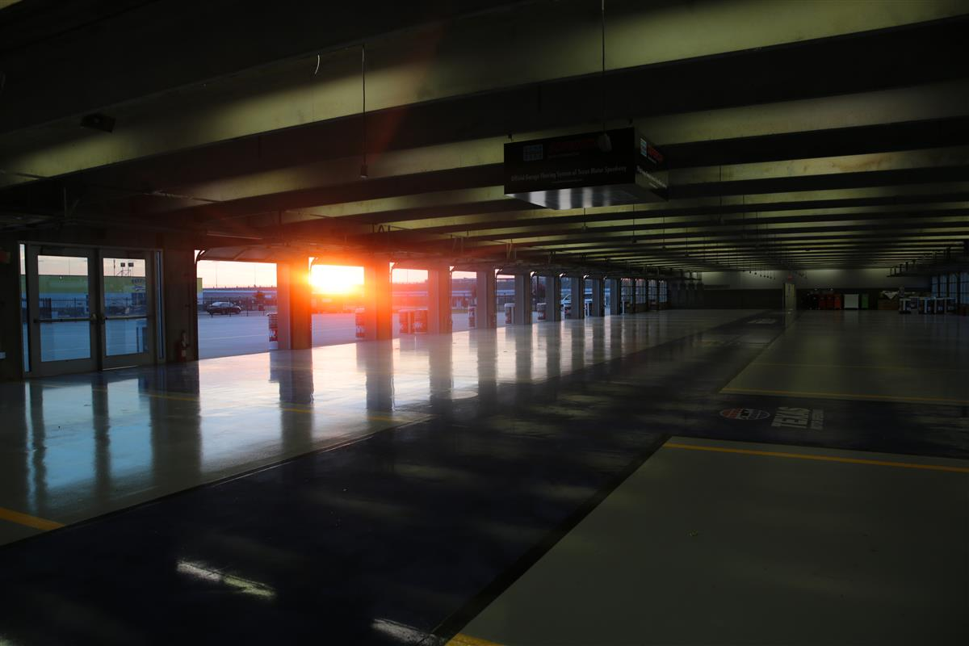
Preparation
Understand the Rules
No Seriously – know the Rules
Did I mention the Rules?
Waivers
Waivers are your way to do something different than the rules that still accomplishes the intent of the rule
Must be requested prior to May 1st
Build you car and Practice before you arrive
Single biggest factor in success

Slide 6
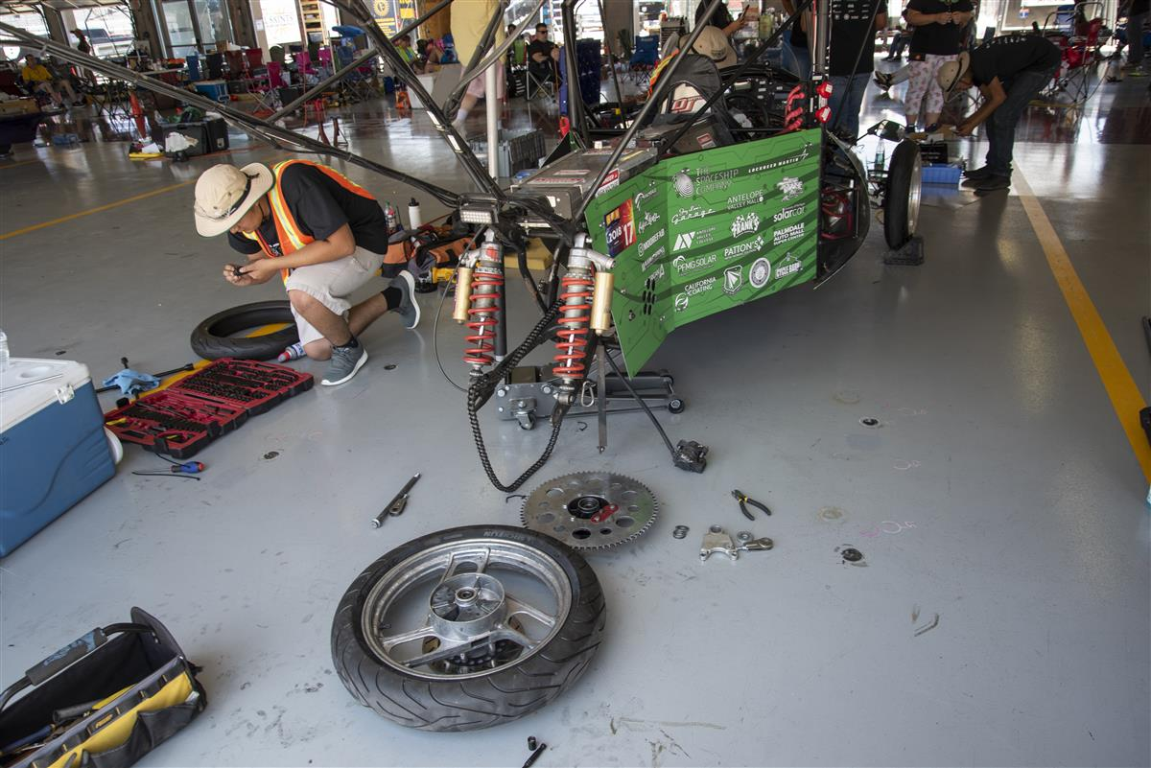
Winning Scrutineering
Be ready to go at 8AM the first day
Visit every Station as soon as you can, even if you don’t think you will pass everything
Get as much feedback as possible from stations BEFORE fixing problems
Sponsors and Advisors cannot be present at the stations do not rely on them for scrutineering
No excuse for students not knowing their car
Walk, don’t run
Don’t be in a rush – keep calm, keep focused
Shop safety rules – DON’T BE UNSAFE
Do not be afraid to elevate serious issues

Slide 7
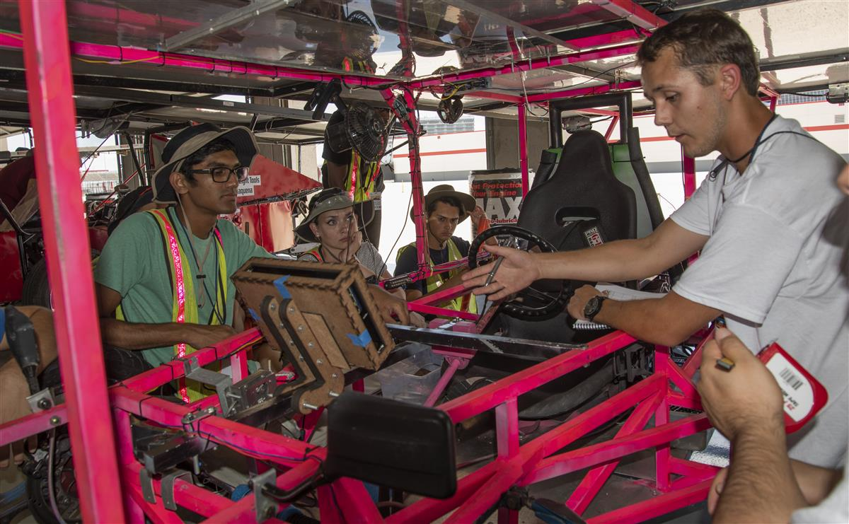
Station 1: Mechanical
Structural Inspections
General Compliance
Common Issues
Size / Clearance
Visibility for every driver
Light Brightness / function
Crush Zones
Role Bars
Locking Fasteners

Slide 8
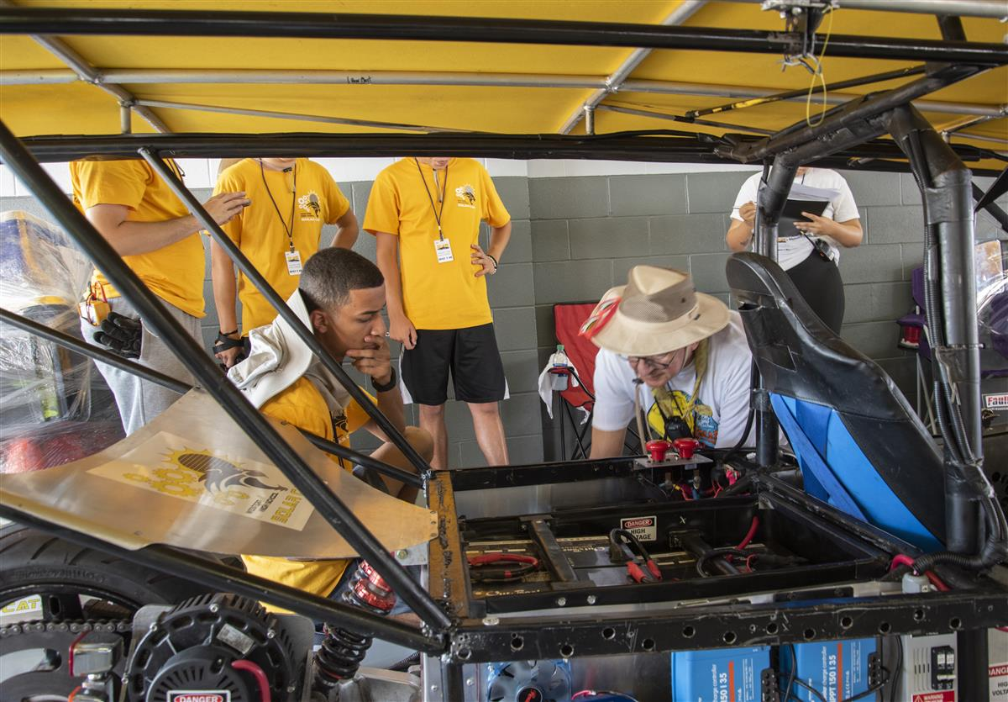
Station 2: Electrical
Electrical System Inspections
Common Issues
Wiring diagrams don’t match
Don’t Understand calculations
Wire Size
Fuse Rating
Battery Capacity
Grounding to the frame of the vehicle
Rat’s Nest
Exposed connections

Slide 9
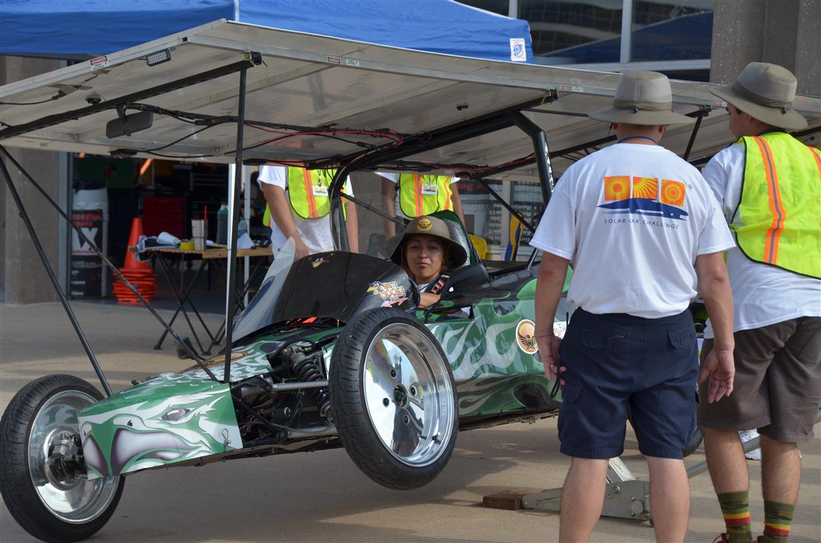
Station 3: Tilt and Turn
Suspension and Steering Inspections
15m U turn
Tilt Car 15 degrees on each side
Common Issues
Can’t Jack up the car
Can’t make the turning radius
Suspension component failures

Slide 10
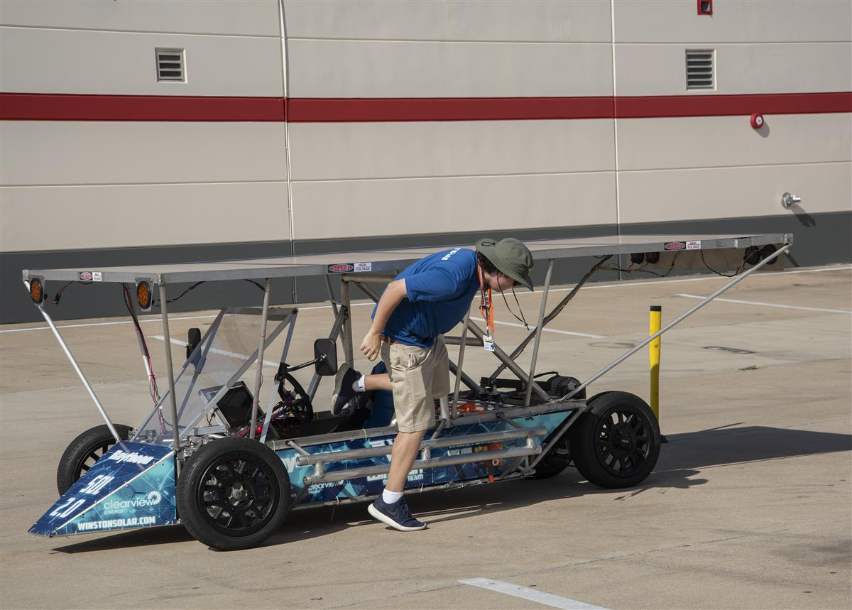
Station 4: Slalom
Dynamic Stability, Emergency Egress, Driver Clearance, Driver Capability
Common Issues:
First time driving the car
Large Drivers don’t meet minimum clearance
Panic due to thinking the car is actually on fire
Notes:
(Bring your licenses!)

Slide 11
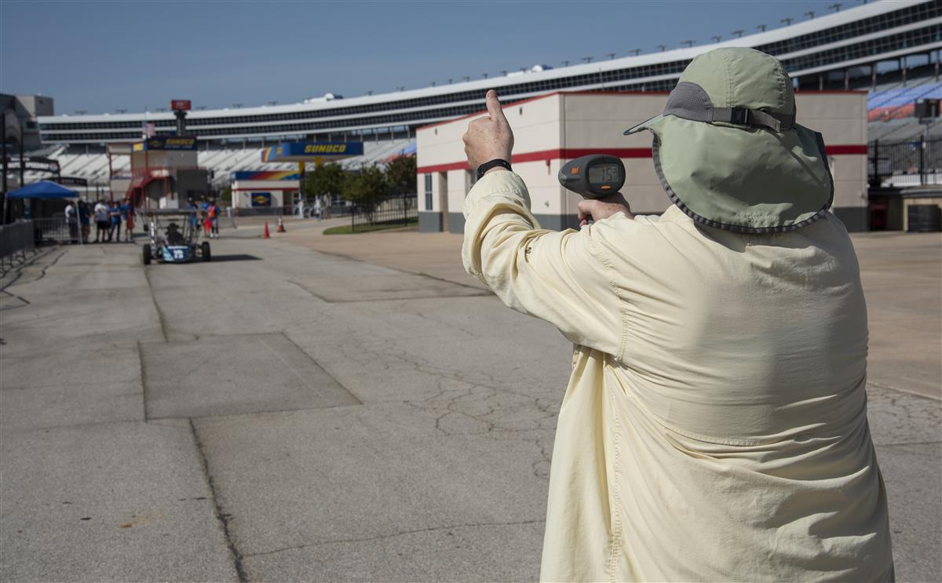
Station 5: Braking
Everything Brakes
Common Issues
Unstable Stop
Brakes not bled
Brakes under powered
Single pedal
Under Designed pedal or pedal mounts
Can’t Meet minimum speed

Slide 12
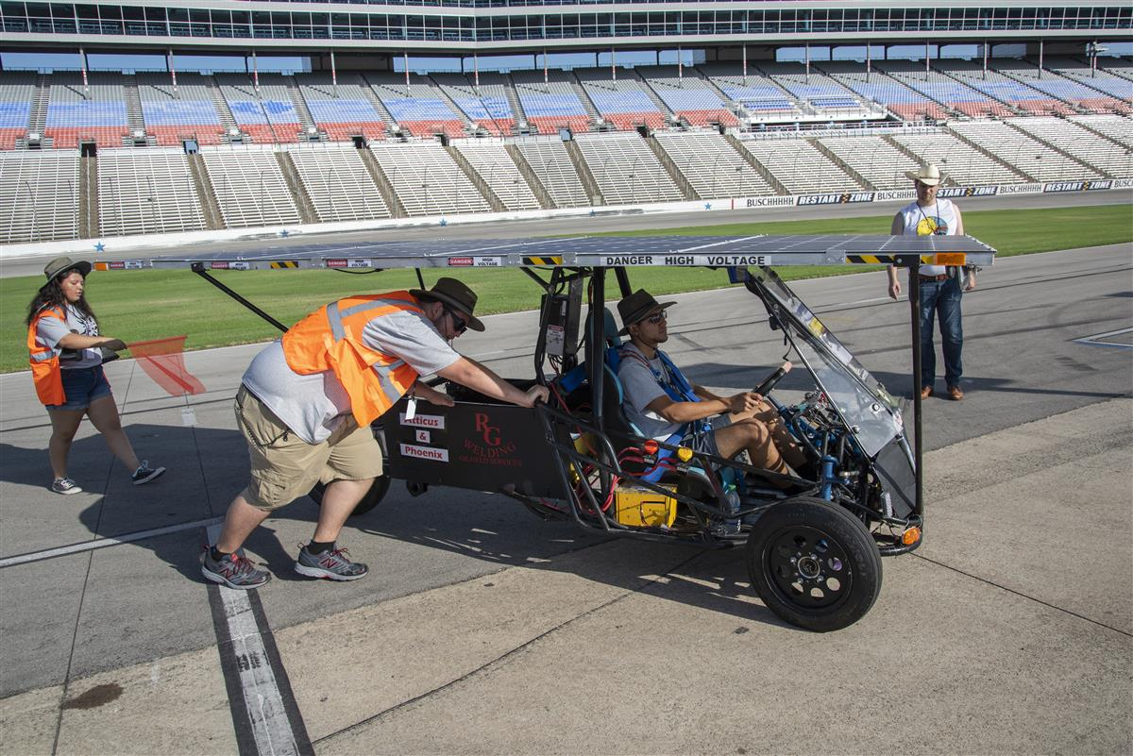
Station 6: Endurance Test
Track Orientation (Track Event)
Full Speed Lap / Stop
Communications Test
Simulated Breakdown and Retrieval
Common Issues
ECCO Lights
Missing Items in the Chase Vehicle
Radio Failure
Not know how to trailer
Loading unsafely
Vehicle Seating
Lack of vehicle to pull trailer

Slide 13
Station 7: Cross Country
Stability When being passed (Cross Country Races only)

Slide 14
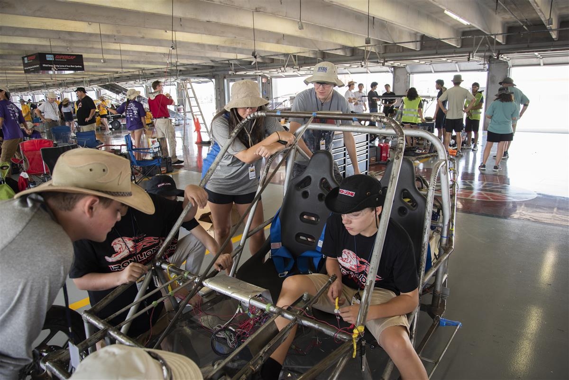
Station 8: Electric Solar Vehicle Station
ESV Division only
Battery Swap Procedures
Charging Station Inspection
Common Issues:
Similar to Electrical Station
Battery swapping for the first time
Charging Station stability
What? Someone has to stay with the station?

Slide 15
Additional Guidance
Rules…
Practice Scrutineering at home
Wait, did I mention to read the rules?
Veteran teams are a resource – especially if you are struggling

Slide 16
Key takeaways to win scrutineering
Finish your car early, put miles on it and do a practice scrutineering
If you are worried about something, or want to do something outside the wording of the rules, email us! Request a waiver (before May 1st)
Know your car
At scrutineering if the is a disagreement escalate to the head judge of the station or to the Technical Director / Chief Judge
Don’t spend all of your time fixing problems if you haven’t been through every station yet – find out what you don’t know
Seriously don’t panic you have already done harder things than scrutineering. Be smart, make any fixes, and get in the event

Slide 17
Questions?

